Slide 1


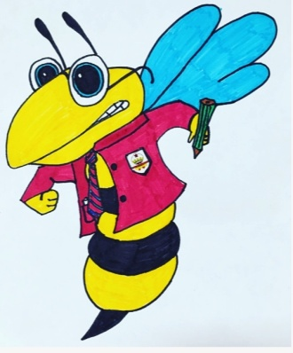
Our literacy focus for
October is...
PUNCTUATION

Slide 2
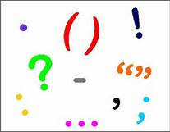
Learning Intention
To learn when different types of punctuation are required.
Success Criteria
I can use punctuation accurately.

Slide 3

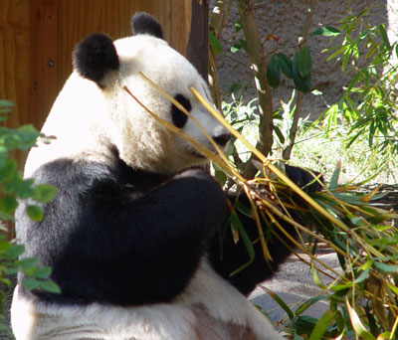
Why is Punctuation Important?
Without punctuation your meaning could be completely misinterpreted:
Eats, shoots and leaves vs Eats shoots and leaves

Slide 4


What is the difference in meaning here?
I want a man who knows what love is all about. You are generous, kind, thoughtful. People who are not like you admit to being useless and inferior. You have ruined me for other men. I yearn for you. I have no feelings whatsoever when we're apart. I can be forever happy - will you let me be yours?
VS
I want a man who knows what love is. All about you are generous, kind, thoughtful people, who are not like you. Admit to being useless and inferior. You have ruined me. For other men, I yearn. For you, I have no feelings whatsoever. When we're apart, I can be forever happy. Will you let me be?

Slide 5
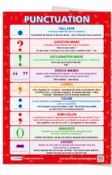
Difficulty Scale
There are lots of different types of punctuation and some types are harder to use than others. Therefore...
All S1 and S2 should master:
Full stops
Question marks
Exclamation marks
Speech marks
All S3 and S4 should master all of the above plus:
Ellipses
Commas
Brackets
All S5 and S6 should master all of the above plus:
Dashes
Colons
Semi colons
However, you could aim to master as many as you can!

Slide 6
Punctuation Uses: S1-2
Full stop: highlights the end of a sentence that is a statement.
e.g. This is a statement to show how a full stop is used.
Question mark: shows a question is being asked.
e.g. Do you know when to use a question mark?
Exclamation mark: shows an extreme emotion is expressed such as shock, surprise, excitement.
e.g. It’s coming!
Speech Marks: are placed around speech.
e.g. “Good morning!” Miss MacLean said as the class entered.

Slide 7
Which would you use?
1. It was a dark, stormy night
2 Are you afraid of the dark
3 She could not believe her eyes
4 She shouted go away
5 The creature moved slowly towards her
6 Is this really happening
7 The creature was covered in green scales and had a long tail
8 It leapt forward
9 Don’t hurt me she cried

Slide 8
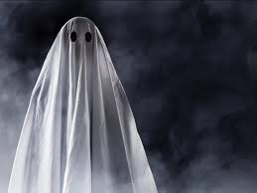
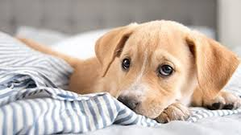
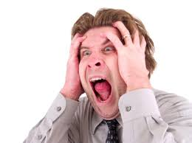
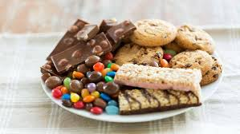
You should write 4 sentences that use each of these types of punctuation. Here are some pictures you could use to inspire you...

Slide 9
Punctuation Uses: S3-4
Ellipses:
Indicates suspense is being built
e.g. She was never ever heard from again...
Indicates pausing
e.g I wasn’t really . . . well, what I mean . . . see, the thing is . . . I didn’t mean it.
Comma:
Separates items in a list e.g. She loved football, tennis and rugby.
Separates extra information e.g. Susan, in S2, played the piano well.
Separates opening phrases e.g. However, he left before she had the chance.
Before a joining word e.g. He was scared of flying, but wanted to go to Florida
Brackets:
Supplies an additional piece of information.
e.g. She had never (and could never) eat fish.

Slide 10
What piece of punctuation would you put where there is a *?
The library was old * smelly and musty.
It was only a matter of time * she prayed * before the announcement was made.
Suddenly* everything went dark*
Taking a great breath beforehand * he shouted.
She had so much to do: homework* cleaning and dog walking.
It was a very long way * and she was exhausted.
Her cake *a stunning Victoria sponge with pink icing* was delicious.
Surely he didn’t think* no, he couldn’t have.
Furthermore* it was highly disrespectful of him.
Her mother *a slim woman of 50* sighed.

Slide 11

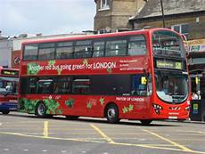
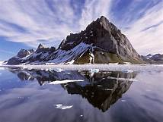

You should now write 3 sentences. One using ellipses, one using a comma and one using brackets. There pictures may inspire you:

Slide 12
Punctuation Uses: S5-6
Colon: Introduces a list, example, explanation or quote.
e.g. She had so much do to that evening: cooking, cleaning and homework.
She couldn’t get her head around History: she could not remember dates.
Trump said: “That’s fake news.”
Dash:
to indicate a change in thought or contrast.
e.g. I pay the bills – my children have the fun.
two dashes can be used instead of brackets.
e.g. It was – he thought – a beautiful view.
Instead of a colon if your writing is more informal.
Semi – Colon:
Links 2 phrases that are complete sentences on their own because they are related.
e.g. The ice-cream truck drove past my house; its music was loud.
Can be used to separate items on a list when the items already contain other punctuation.
e.g. My skills include good communication, especially when writing; strong interpersonal skills (as evidenced in my relationship with colleagues; leadership, as demonstrated during this task.

Slide 13
What piece of punctuation would you put where there is a *?
She loved being outdoors* the breeze, the sun and the smell of the grass.
Jason ran* his bus was about to leave.
She couldn’t understand *and never had* why boys were so immature.
There was the sound of scraping, as if somebody was scratching the floor boards* the lights flickered intermittently* the smell of blood, stale and metallic, drifted into her nostrils.
He was not impressed* the girl had embarrassed him.
In his famous speech, MLK said* “I have a dream”.
It was payday and she had big plans * none of which involved her so called friend.
It was chaos* children screamed, ran and fought.
She couldn’t move* she was frozen with terror.
It was not a good day* Tuesdays never were* as she had her least favourite subject for a double period.

Slide 14

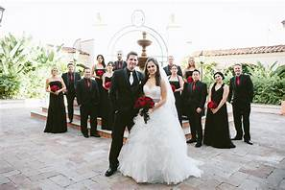
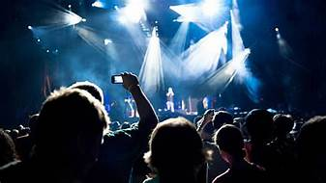
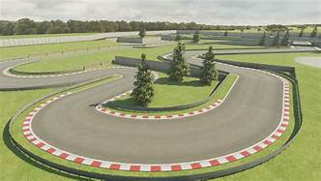
You should now write 3 sentences. One using a colon, one using a dash and one using a semi colon. These pictures may inspire you:

Slide 15
Final Tasks
On the next slide is a paragraph with all punctuation omitted. Re-write the paragraph with the punctuation added in.
You should then complete the story ensuring all punctuation is used accurately.
You could aim to use each type of punctuation at least once.

Slide 16
. ? ! … - ; : , ()
There was so much to do* a cake to be made* balloons to be blown up* and a playlist to be organised* it’s not every day* she thought* that my best friend would be turning 16* suddenly* the doorbell rang* who could that be* she wondered* The bell rang again* it must be urgent* Sarah rushed to the door and looked through the spy hole *nobody was there* suspiciously* she turned the handle* she shrieked* then all went black*

Slide 17
Next Steps
Throughout October, ensure you use punctuation accurately. If you make an error, your teacher will indicate this with the letter P.
S1/2
You should aim to use full stops, question marks, exclamation marks and speech marks correctly.
S3/ 4
You should aim to use full stops, question marks, exclamation marks, speech marks correctly, commas, brackets and ellipses correctly.
S5/6
You should aim to use full stops, question marks, exclamation marks, speech marks correctly, commas, brackets, ellipses, colons, semi colons and dashes correctly.
You could aim to use more complex types of punctuation than you have to.

