Slide 1


Preparing for Midlothian
Spotlight Sessions
Notes:
Hi everyone, I’m *your name* from Developing the Young Workforce and I am here to talk to you about how you can prepare for DYW Roadshow.

Slide 2

What are the Midlothian Spotlight Sessions?
The Midlothian Spotlight Career Sessions are a series of career-themed events across Midlothian High schools to help students explore diverse career pathways and connect with employers.
These sessions are part of the Developing the Young Workforce (DYW) initiative and are designed to inspire and inform S4–S6 pupils about future opportunities.
🎯 Purpose and Audience
Targeted at S4–S6 students in all Midlothian High schools.
Aims to showcase career options across various sectors and help students align their interests and strengths with potential pathways. Pupils/Parents can attend any of the events across the region
Notes:
Read out text

Slide 3

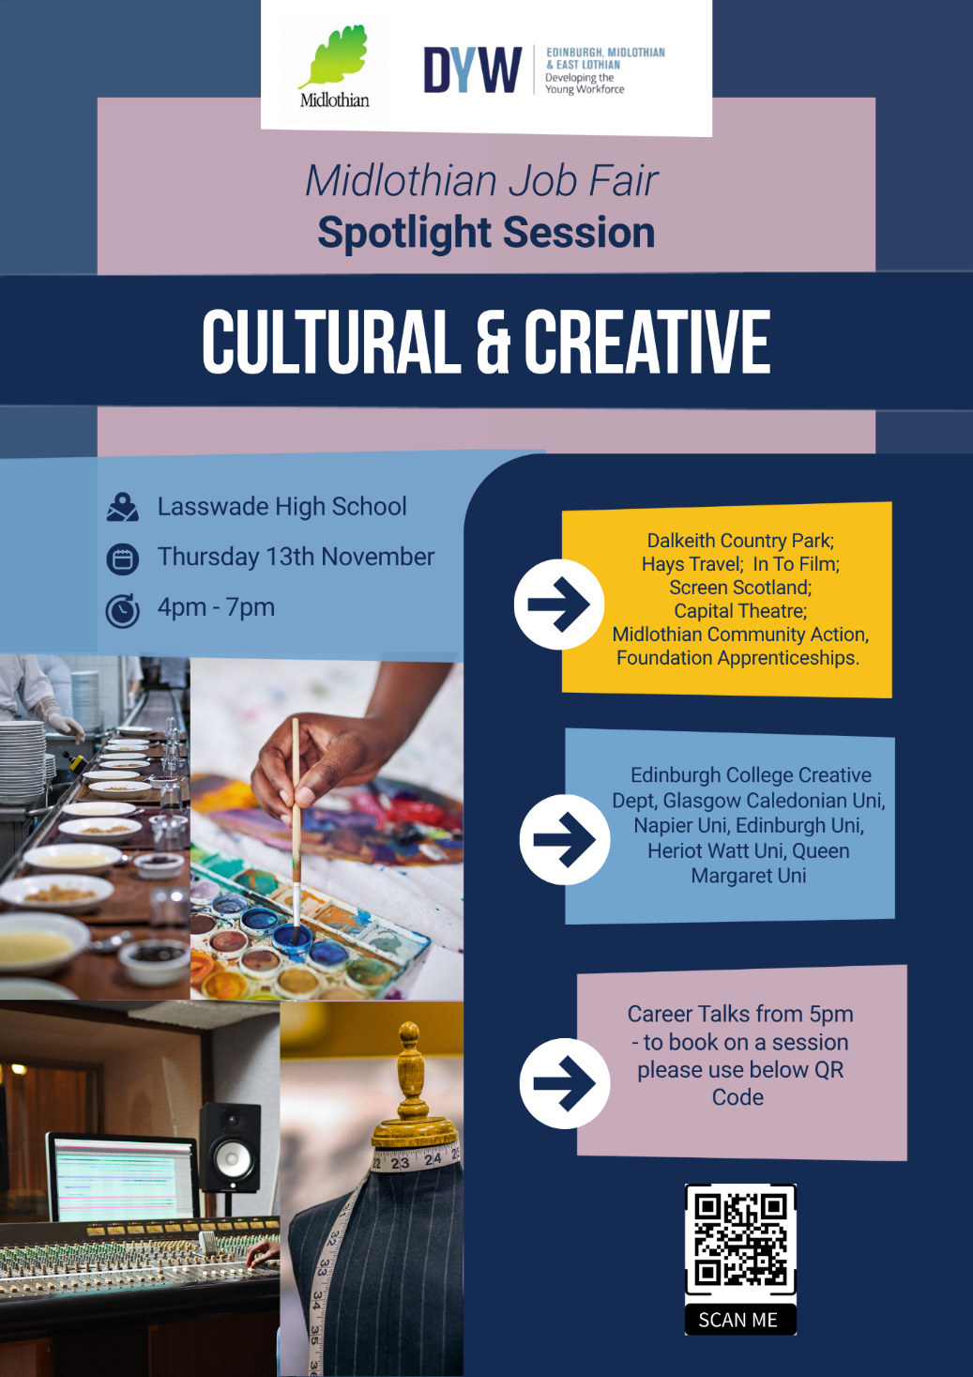

Slide 4

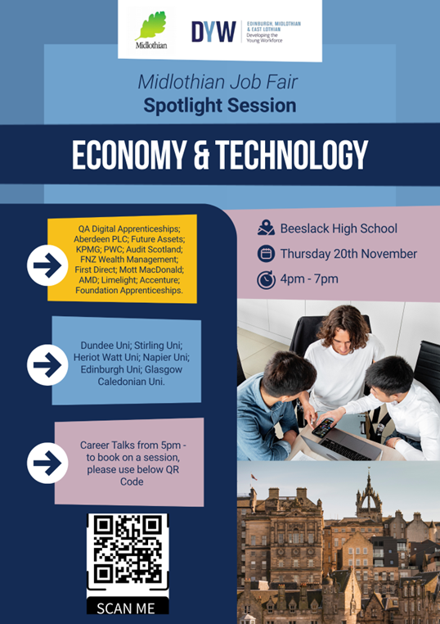

Slide 5


What pathways are available to you?
Foundation Apprenticeships offered in school
Modern Apprenticeships
Graduate Apprenticeships
College & University Courses
Notes:
There are many pathways you can follow into the world of work including: read out text

Slide 6

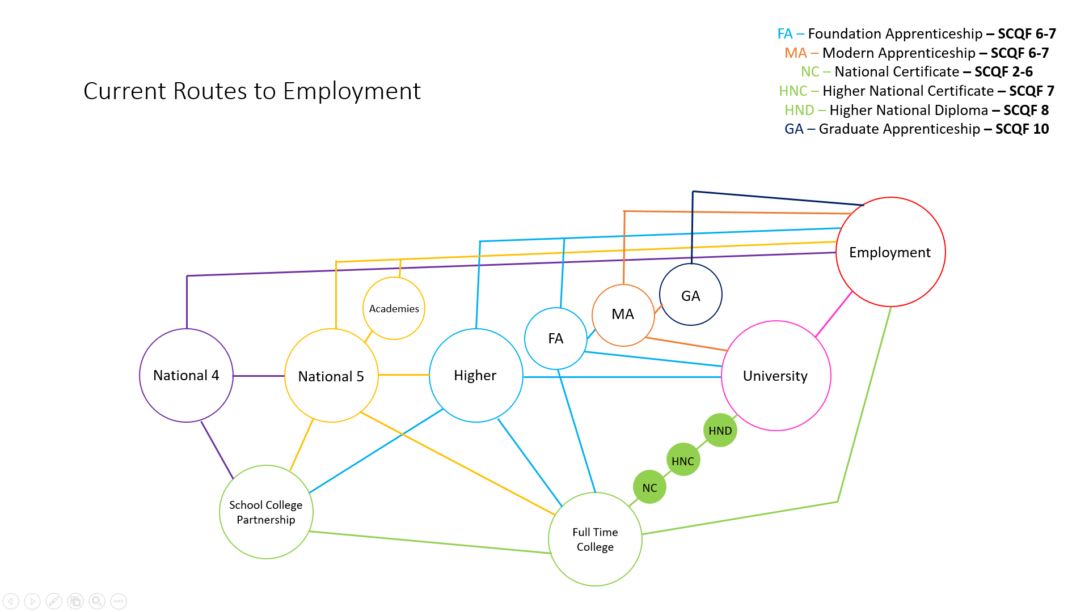
What pathways are available to you?
Notes:
Here is a more in depth map of some of the routes and pathways you could follow when you leave school

Slide 7
What should you do before ?
Prepare key questions you would like to ask
Think about your interests: Which opportunities match your skills or passions?
Select key exhibitors you would like to speak to
Decide which ‘insight career talks’ you’ll attend
Notes:
Read text

Slide 8
What should you do at the event?
Visit the exhibitors you're most keen to speak to first
Talk to exhibitors you hadn’t considered before
Find out from the employer how to stay informed about new opportunities with them
Ask questions
Take notes: Jot down which employers or roles stood out to you and why
Notes:
Read text

Slide 9
What questions should you ask?
What does your business do?
What is your job role?
Do I need to go to College or University?
What specific subjects and what level of Maths & English do I need?
?
What is the best part of your job?
Do you offer apprenticeships
Notes:
On the day it is important to ask employers questions, over the next 3 slides I am going to show you some of the questions you could ask and give you time to make note of any of these. Read out 2 or 3

Slide 10
What questions should you ask?
What qualities do you look for to work for your company?
What skills do you look for?
Do you offer work experience?
What advice would you offer about starting a career in your sector
What pathway did you follow when you left school?
How many different jobs are available in your industry?
Notes:
Read out 2 or 3

Slide 11
What should you do after ?
Research exhibitors you found interesting
Register for alerts on job/apprenticeship websites https://www.apprenticeships.scot/
Review materials: Go over any brochures, business cards, or flyers you collected.
Talk to your parents, friends and teachers about your next steps
Speak with a career advisor and look at MyWoW https://www.myworldofwork.co.uk/
If you didn’t find something that suited you, that’s okay! Use the experience to refine what you’re looking for and keep exploring.
Notes:
Read text

