Slide 1
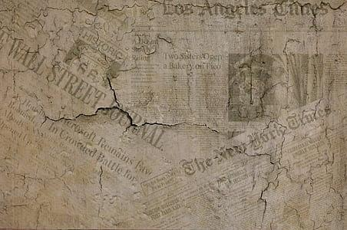
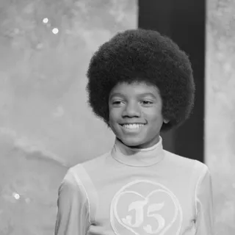
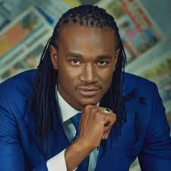
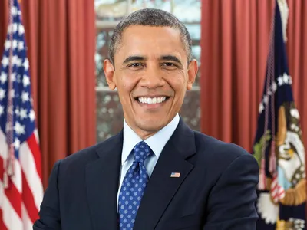
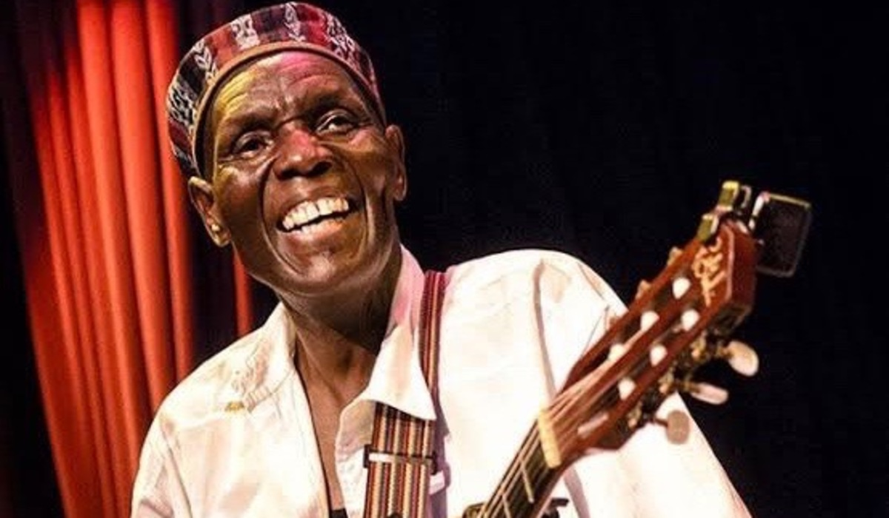
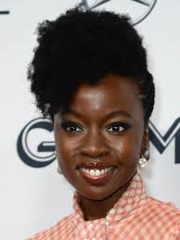
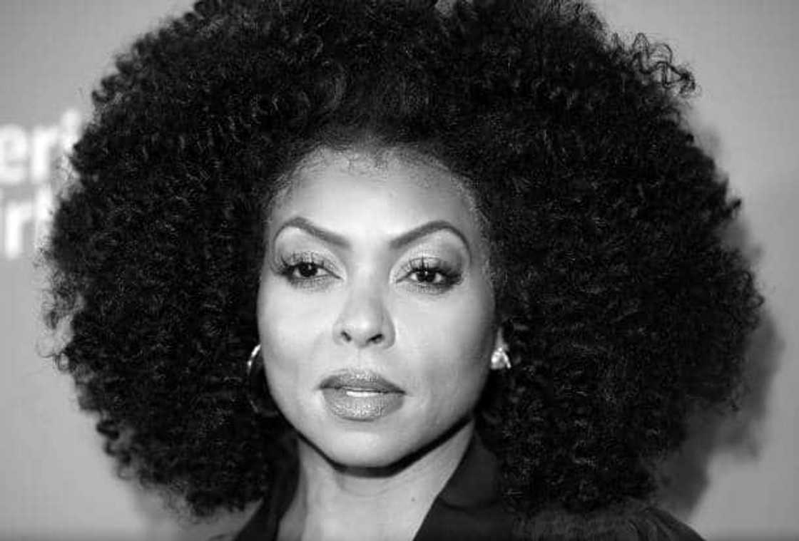
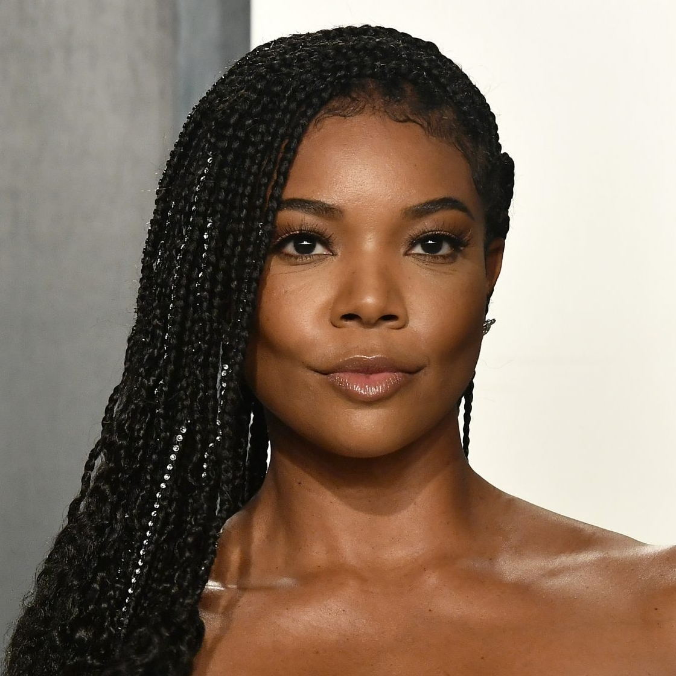
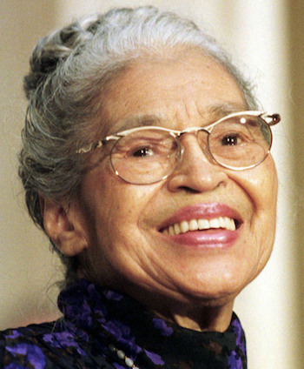
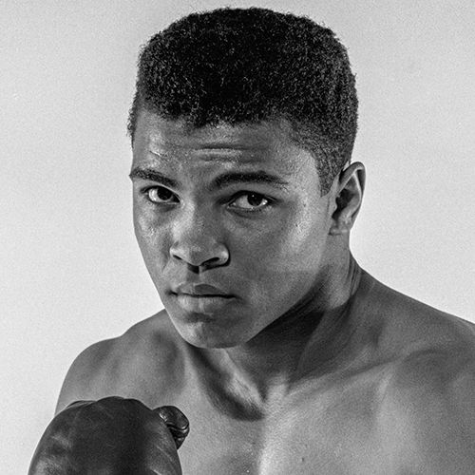
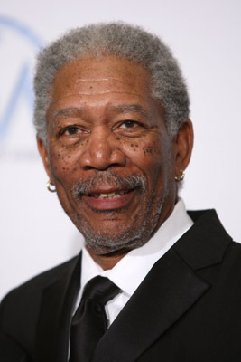
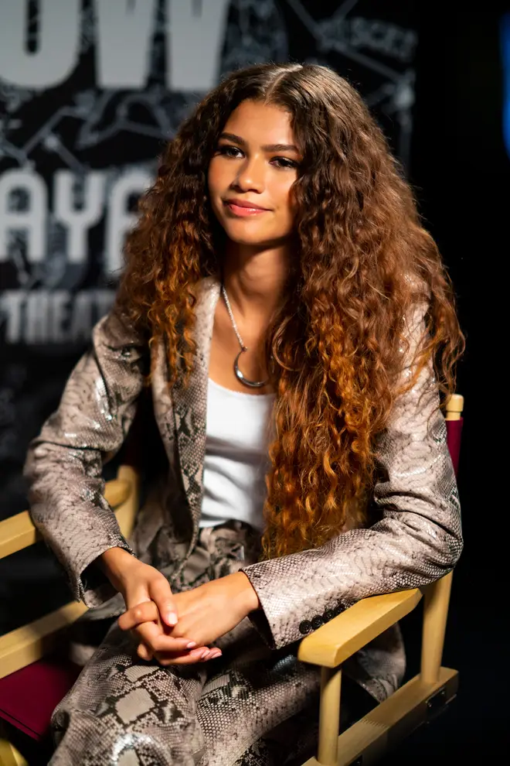
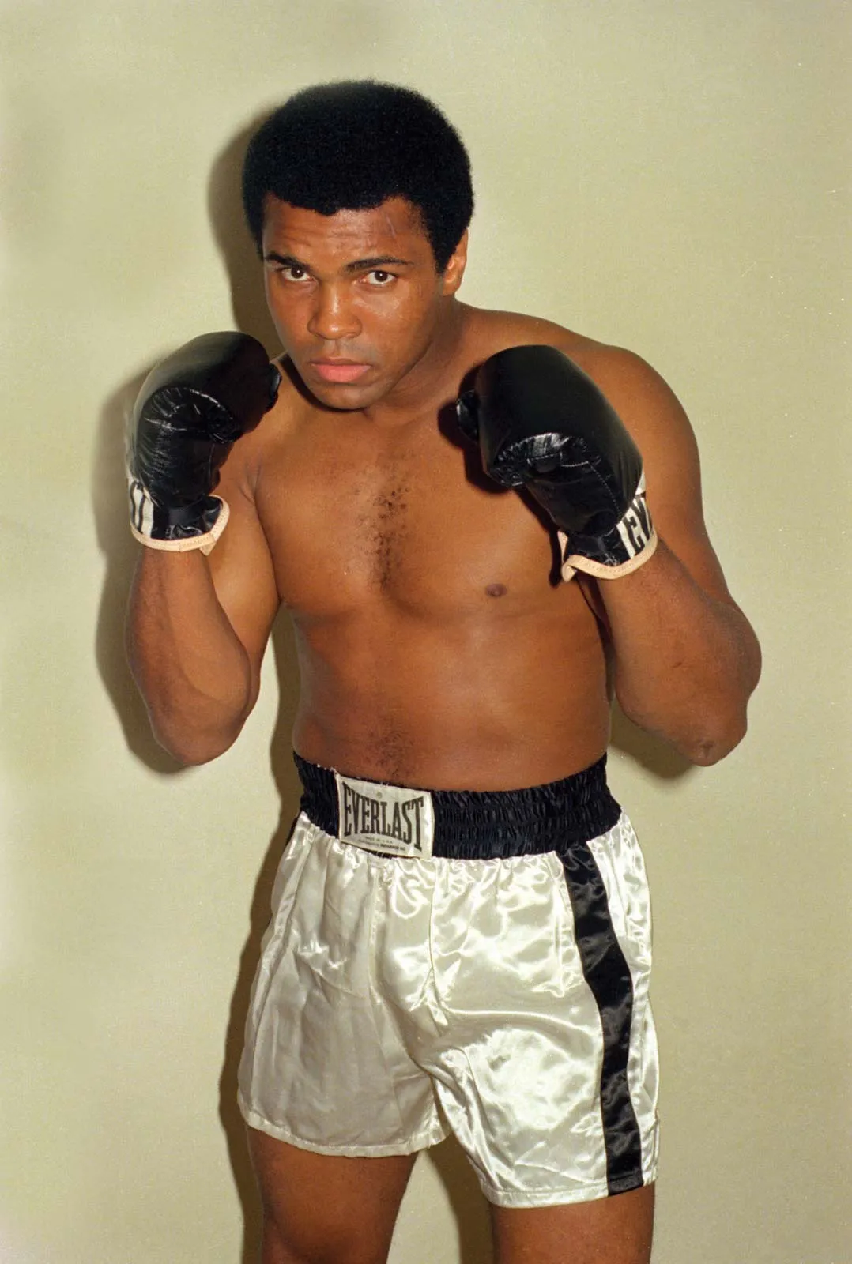
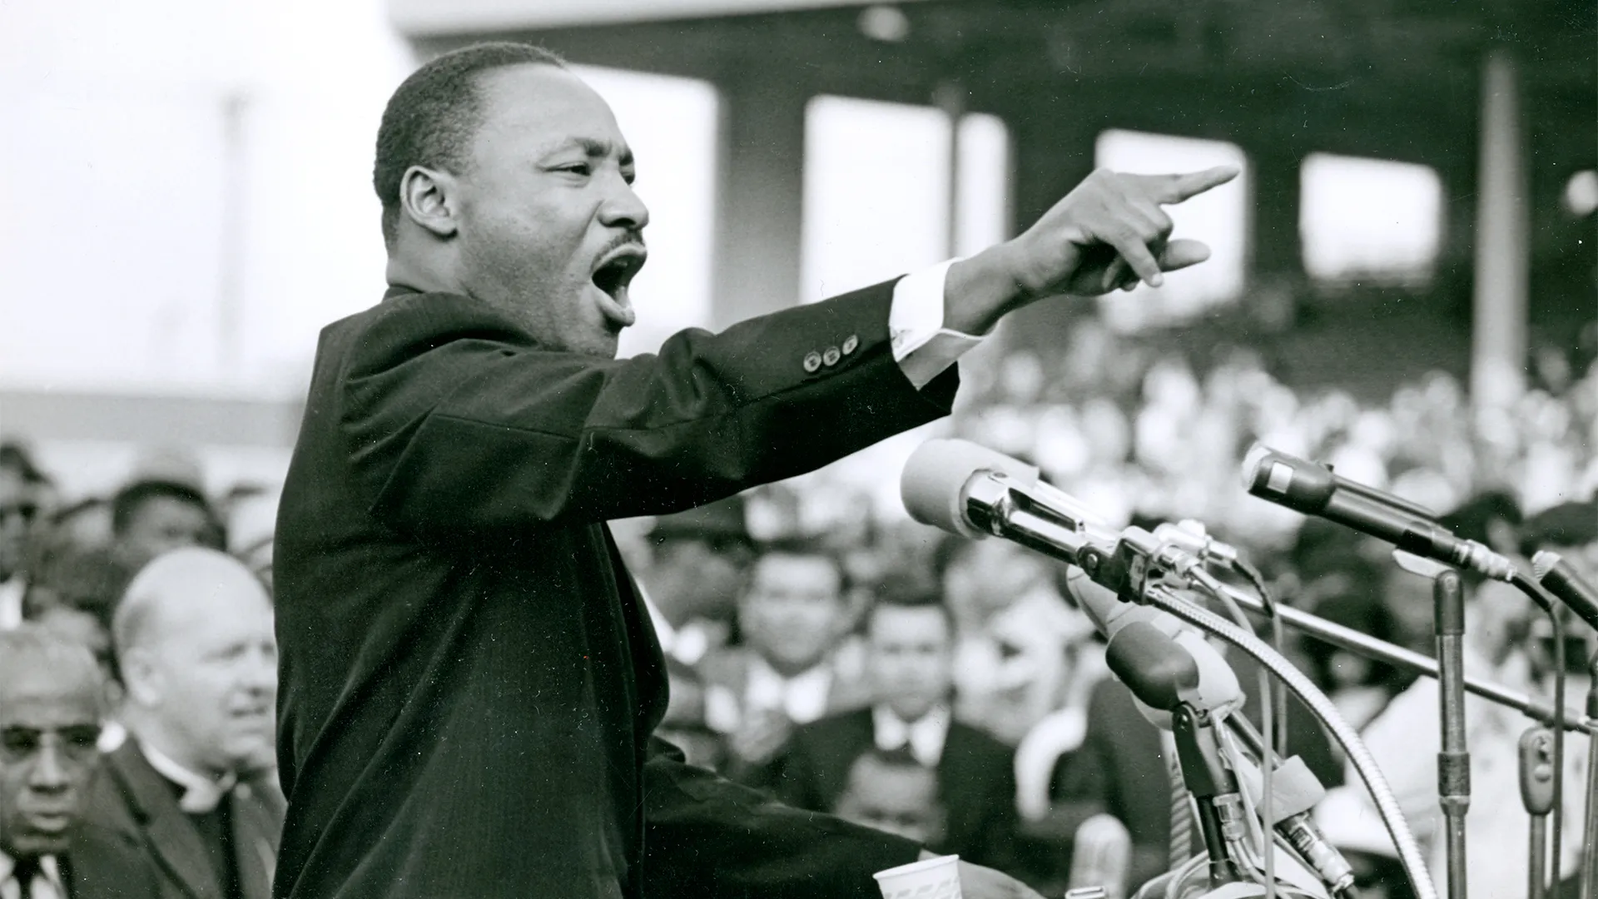
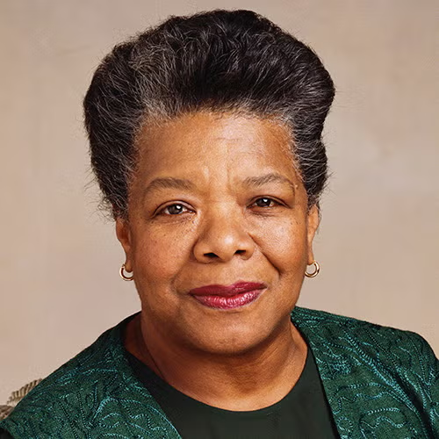
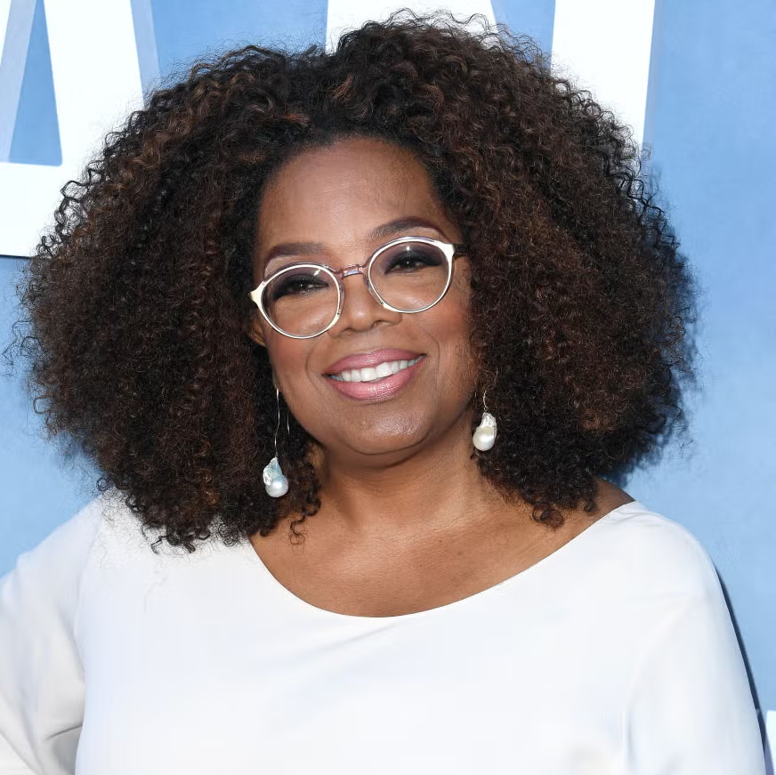
Black history month

Slide 2

Standing firm in power and pride
“Standing Firm in Power and Pride,” a powerful tribute to the resilience, strength, and unwavering commitment to progress that defines the Black community across the globe. This year, the theme highlights the profound contributions made by Black people be they leaders, activists, or pioneers who have shaped history, while also looking towards a future of continued empowerment, unity, and growth.

Slide 3
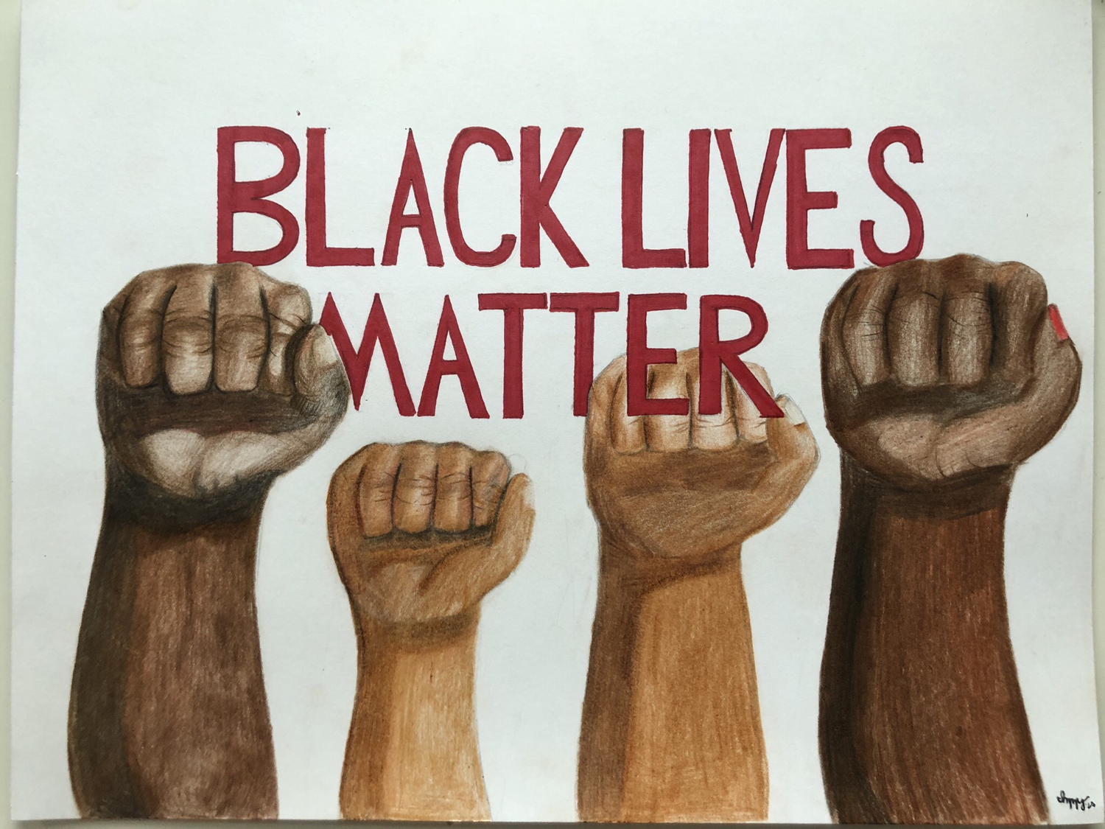
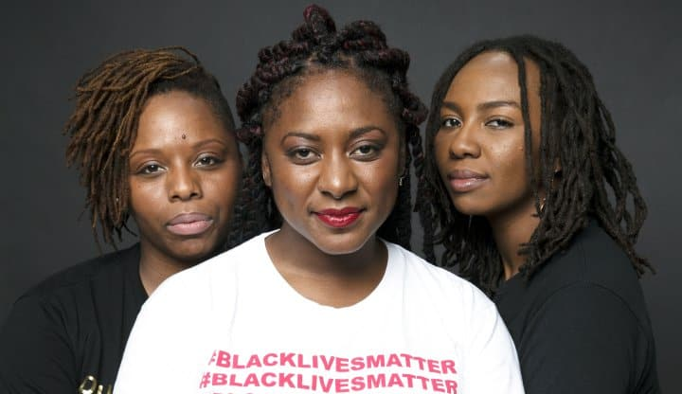
Black lives matter meaning
Black Lives Matter is a political and social movement that aims to highlight racism,police brutality,discrimination and racial inequality experienced by black people.
The origin of BLM started in 2013 when three radical black organizers Alicia Garza,Patrisse Cullors and Opal tometi created a political centered movement #BlackLivesMatter in response to trayvon Martin's murderer.

Slide 4
We Rise
(School Version) adapted by Darren Machiwana
We come from dreamers, brave and strong,
Who fought for what was right,
They taught the world to stand with pride,
And shine their brightest light.
They marched in streets, they raised their hands,
They spoke so all could hear,
Their courage built the path we walk,
Their voices guide us near.

Slide 5
From classrooms now to far-off stars,
Their dreams still help us grow,
Because of them, we stand today—
And let our greatness show.
So when we learn, and when we lead,
We honor those before,
Their strength, their love, their endless hope,
Will live forevermore.
We rise with pride in who we are,
With hearts both brave and true,
For Black history lives in us—
And shines in all we do.

Slide 6
